Slide 1
How to attract Millennials to your Meeting or Program
Johnnie White

Slide 3
Marketing Check List
Speak to their values
Provide experience
Video is a critical tool
Provide discounts or FREE access
Seek authentic engagement
60 %of Millennials like receiving a touchpoint message unrelated to selling a product

Slide 4
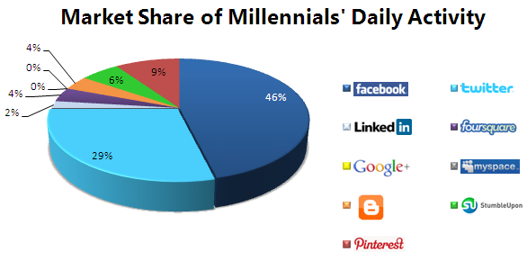
Marketing Check List
Go beyond traditional advertising
Be present where they are

Slide 5
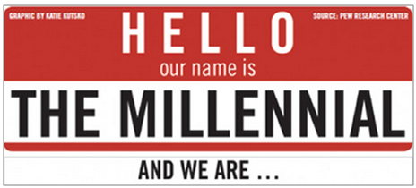

Slide 6
Goal Oriented – Success Driven
Millennials want access to Mentors that will help them in learning how to meet their goals.
Millennials want continuous feedback.
Millennials are seeking fast tracks to advancements.

Slide 7
Solutions:
Provide networking opportunities where they can meet
potential mentors
Develop and present self assessment sessions.
Include Career Development topics in your program.
Job Fairs.

Slide 8
Independent – Self Reliant
Millennials are delaying marriage and having children as they want to take time to find themselves
Millennials are hard workers, but seek a balanced work and personal lifestyle
Millennials want to participate in solving problematic issues, not sold to

Slide 9
Solutions:
Make the program fun and interesting
Setup the sessions with 15-20 minute blocks or 1
hour block sessions with 3 to 4 different speakers
Provide interactive sessions where it includes
hands-on training
Create a community/campus like community

Slide 10
Technology Addiction

Slide 11
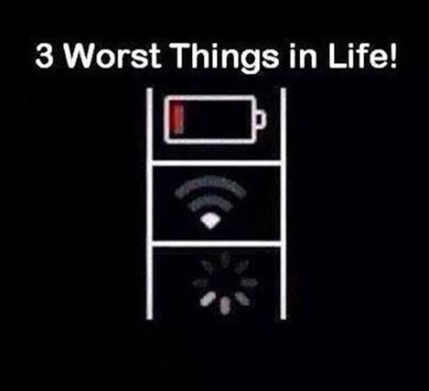

Slide 12
Technology Addiction
Millennials check their smartphones 43 times per day.
Millennials are addicted to social media
Millennials will give personal information to a trusted brand.

Slide 13
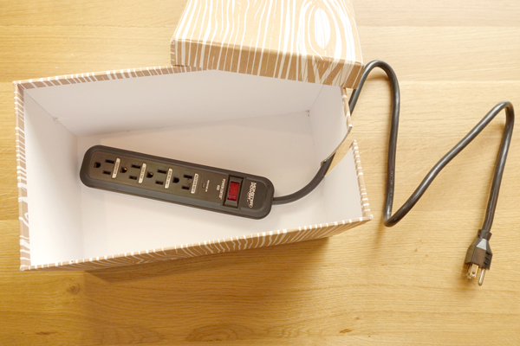
Solutions:
Gather as much information as possible from your attendees.
Be sure to have adequate bandwidth and charging outlets at your meeting.
Provide access to the attendees through your online programs.
Include social media in your program
Have a meeting app or webbase program

Slide 14
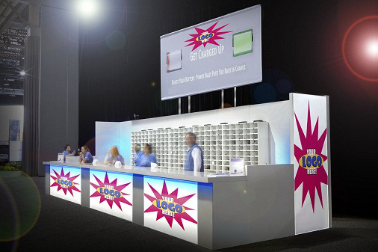
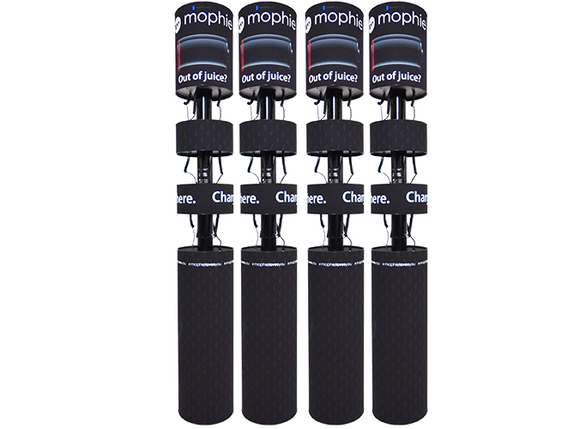
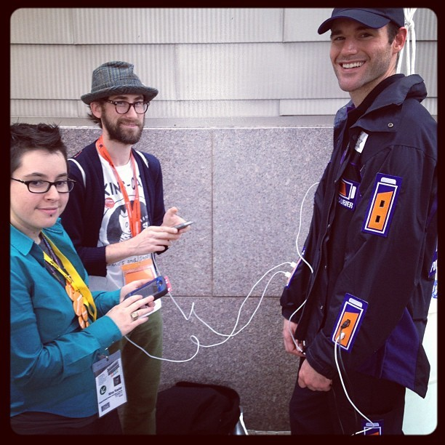
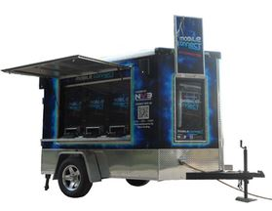

Slide 16
https://www.youtube.com/watch?v=BiBkS1UuBo0
https://www.youtube.com/watch?v=BiBkS1UuBo0

Slide 17
Thank You
Johnnie White

